Slide 1
N5 Computing Science
Computer Systems

Slide 2
Plan – N5 Year 1
SDD
Software Design and Development (40%)
DDD
Database Design and Development (25%)
Web Design and Development (25%)
WDD
Computer Systems (10%)
C/Sys
Notes:
Hide as appropriate

Slide 3
Plan – N5 Year 2
SDD
Software Design and Development (54%)
DDD
Database Design and Development (33%)
Assignment (⅓ of marks)
Computer Systems (13%)
C/Sys
Exam (⅔ of marks)
Notes:
Hide as appropriate
Prelim 1 ~ end of SDD
Prelim 2 ~ end of DDD

Slide 4
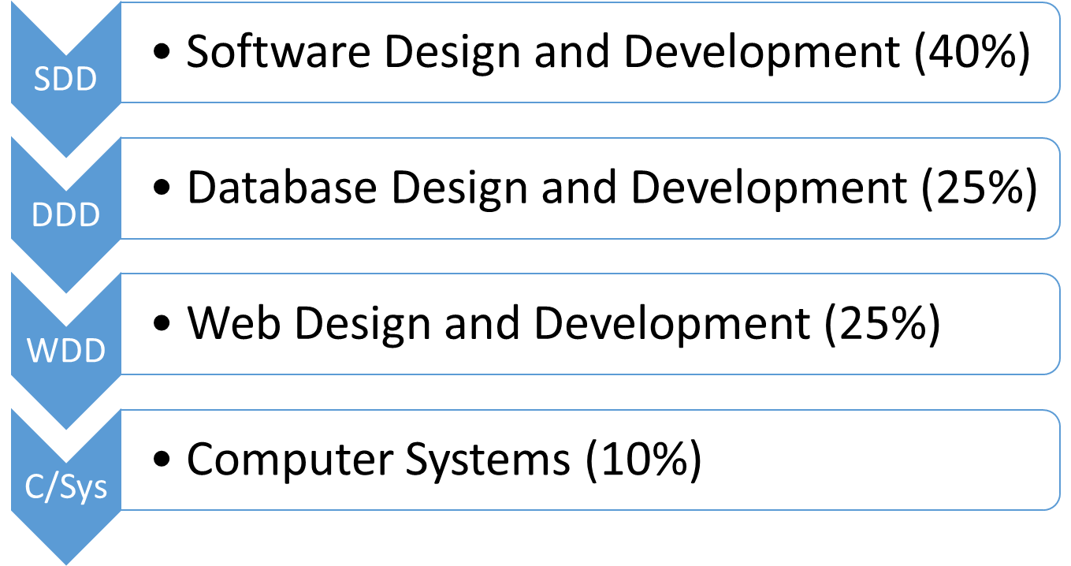
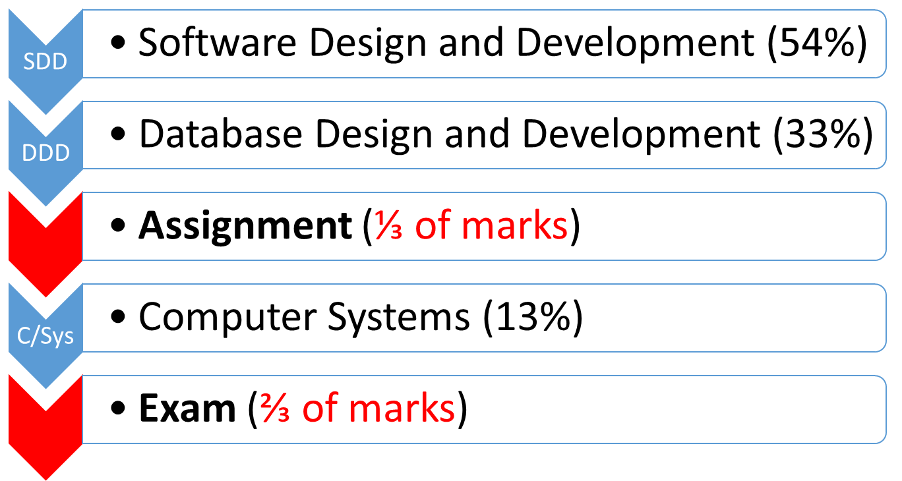
N5 Computing Science
Year 1
Year 2

Slide 5
Data Representation
Computer Systems

Slide 6
Binary
Notes:
https://www.omnicalculator.com/math/twos-complement

Slide 7
Learning Objectives
Describe and exemplify the use of binary to represent positive integers.
Convert from binary to denary.
Convert from denary to binary.

Slide 8
Denary (Base 10)
Place determines the value of a digit
10³
10²
10¹
10⁰
1000
100
10
1
7
3
7
3
Base
Base
10
7000
70

Slide 9
Denary (Base 10)
Place determines the value of a digit
1000
100
10
1
7
3
7
3

Slide 10
Why Binary?
Computers can store information using:
Electricity
Magnetism
Need to represent Off and On
Binary uses 0 and 1
Note: A binary digit (0 or 1) is known as a bit
Notes:
Electricity – RAM volatile
Magnetism – HDD non-volatile

Slide 11
Why Binary?
Computers can store information using:
Electricity
Magnetism
Need to represent and
Note:

Slide 12
Number Systems
Denary
Binary
Used by: humans
Digits: 0, 1, 2, 3, 4, 5, 6, 7, 8, 9
No of digits: 10
Multiplier: 10
Known as: Base 10
Used by: computers
Digits: 0, 1
No of digits: 2
Multiplier: 2
Known as: Base 2

Slide 13
Number Systems
Denary
Binary
Used by:
Digits:
No of digits:
Multiplier:
Known as:
Used by:
Digits:
No of digits:
Multiplier:
Known as:

Slide 14
Binary (Base 2)
Place determines the value of a digit
2³
2²
2¹
2⁰
8
4
2
1
1
0
1
0
Base
Base
2
8
2

Slide 15
Binary (Base 2)
Place determines the value of a digit
8
4
2
1
1
0
1
0

Slide 16
Binary Place Values – 8 bits
MSB
LSB
bit:
7
6
5
4
3
2
1
0
place
value:
128
64
32
16
8
4
2
1
MSB = Most Significant Bit
LSB = Least Significant Bit
x2
x2

Slide 17
Binary Place Values – 8 bits
bit:
7
3
2
1
0
place
value:
1
MSB = Significant Bit
LSB = Significant Bit

Slide 18
Binary to Denary
Convert the following 4-bit binary value to denary:
MSB
LSB
8
4
2
1
8
+ 2
1
--
11
==
1
0
1
1
Add place values of 1s

Slide 19
Binary to Denary
Convert the following 4-bit binary value to denary:
+
--
1
0
1
1

Slide 20
Binary to Denary - Practise
Convert the following binary values to denary:
0101
110011
10100101
Notes:
a 5 b 51 c 165

Slide 21
Denary to Binary
Convert the following denary value to 4-bit binary :
Is 6 >= 8?
False (0)
Is 6 >= 4?
True (1)
6 – 4 = 2
Is 2 >= 2?
True (1)
2 – 2 = 0
Is 0 >= 1?
False (0)
Working
MSB
LSB
8
4
2
1
6
0
1
1
0

Slide 22
Denary to Binary
Convert the following denary value to 4-bit binary :
Is 6 >= 8?
Is 6 >= 4?
Is 2 >= 2?
Is 0 >= 1?
MSB
LSB
8
4
2
1

Slide 23
Denary to Binary - Practise
Convert the following denary values to binary:
13 (4 bits)
31 (6 bits)
204 (8 bits)
Notes:
a 1101 b 011111 c 11001100

Slide 24
Floating-Point
Real numbers
Notes:
https://www.omnicalculator.com/math/twos-complement

Slide 25
Revision - Binary
Place values for 8 bits
0101 0111 to denary
1010 1010 to Base 10
17 to binary
198 to Base 2
Notes:
0101 0111 = 87, 1010 1010 = 170
17 = 0001 0001, 198 = 1100 0110

Slide 26
Learning Objectives
Describe floating point representation of positive real numbers using the terms mantissa and exponent.

Slide 27
Scientific Notation
Integer part
7395
7·395 × 10³
0·00529
5·29 × 10⁻³
Integer part always from 1 to 9

Slide 28
Scientific Notation
7395
0·00529
Notes:
Note: only ever a decimal value, i.e. 0 point something

Slide 29
Floating Point
Integer part
7395
0·7395 × 10⁴
0·00529
0·529 × 10⁻²
Integer part is always 0
Notes:
Note: only ever a decimal value, i.e. 0 point something

Slide 30
Floating Point
7395
0·00529
Notes:
Note: only ever a decimal value, i.e. 0 point something

Slide 31
Terminology
Exponent
Value: 0·00529
0·529 × 10⁻²
Mantissa
Base
Notes:
Only decimal part, no integer
See 2018 Specimen Q12, 2018 Q4(b), 2019 13(d), 2022 Q5, 2023 Q10(a)

Slide 32
Terminology
Value: 0·00529
0·529 × 10⁻²
Notes:
Only decimal part, no integer

Slide 33
Binary
Exponent
Value: 10101
0·10101 × 2¹⁰¹
Mantissa
Base
As the base is always 2, only values for the mantissa and exponent are used
Notes:
The 2 is in denary as 2 in binary is 10!

Slide 34
Binary
Value: 10101
0·10101 × 2¹⁰¹

Slide 35
Floating Point - Practise
Identify the mantissa and exponent of the following values:
0·674 × 10³
25000
0·00094
M: 674 E: 3
M: 25 E: 5
M: 94 E: -3
Notes:
(a) 674, 3 (b) 25, 5 (c) 94, -3

Slide 36
Floating Point - Practise
Identify the mantissa and exponent of the following values:
0·674 × 10³
25000
0·00094

Slide 37
ASCII
Notes:
https://whiteboard.fi/

Slide 38
Learning Objectives
Describe extended ASCII code (8-bit) used to represent characters.

Slide 39
Encoding
Character encoding is the method used to represent characters as numbers that computers can understand.

Slide 40
Encoding
ASCII is an example of encoding
Encoding changes data from one form to another
Morse Code is also an example of encoding
ASCII
S = 83
SOS = 83 79 83
Morse Code
S = ●●●
SOS = ●●● ––– ●●●

Slide 41
Encoding
ASCII is an example of
Encoding changes data from one
Morse Code is also an example of
ASCII
S = 83
SOS = 83 79 83
Morse Code
S = ●●●
SOS = ●●● ––– ●●●

Slide 42
ASCII
American
Standard
Code for
Information
Interchange
7 bits (2⁷ = 128)
Each value represents a single character
Control characters:
10 = Line Feed
13 = Carriage Return
Printing characters:
65 = A 90 = Z
97 = a 122 = z
Notes:
https://en.wikipedia.org/wiki/ASCII

Slide 43
ASCII
A
S
C
I
I
bits (2⁷ = )
Each value represents a character
Control characters:
10 = Line Feed
13 = Carriage Return
Printing characters:
65 = 90 =
97 = 122 =

Slide 44
Extended ASCII
8 bits (2⁸ = 256)
Hello – 5 characters
Each character has 8 bits
5 × 8 = 40 bits
Notes:
https://www.ascii-code.com/

Slide 45
Extended ASCII
bits (2 = )
Hello – characters
Each character has bits
5 × 8 = bits

Slide 46
Characters
Printable
Control
A
3
@
New line ("\n")
Tab ("\t")
Bell (chr(7))

Slide 47
Characters
Printable
Control

Slide 48
ASCII - Practise
Calculate the number of bits required to store the following:
Magic
Lets go!
C@stl3bay.
Notes:
(a) 5 x 8 = 40 (b) 8 x 8 = 64 (c) 10 x 8 = 80

Slide 49
Vector Graphics
Notes:
2013 Q25(a), 2018 Q22(b), 2018 Specimen Q8, 2019 Q12, 2021 Q9, 2023 Q1

Slide 50
Learning Objectives
Describe the vector graphics method of graphic representation for common objects:
Line
Rectangle
Ellipse
Polygon
and attributes
Notes:
Polygon – a shape with straight sides (regular and irregular shapes )
https://www.adobe.com/creativecloud/file-types/image/vector.html

Slide 51
Vector Graphics
Image created using shapes
Shapes are drawn using instructions
Images are resolution independent – never pixelated
Smaller file size (normally)
Notes:
https://deliciousbrains.com/svg-advantages-developers/

Slide 52
Vector Graphics
Image
Shapes
Images

Slide 53
Line
x1 co-ordinate
y1 co-ordinate
x2 co-ordinate
y2 co-ordinate
Line colour
Line thickness

Slide 54
Line

Slide 55
Rectangle
x co-ordinate
y co-ordinate
Fill colour
Height
Line colour
Line thickness
Width

Slide 56
Rectangle

Slide 57
Ellipse
Fill colour
Radius x
Radius y
Centre:
x co-ordinate
y co-ordinate
Line colour
Line thickness
Circle: Radius x = Radius y

Slide 58
Ellipse

Slide 59
Polygon
co-ordinate 1
co-ordinate 2
co-ordinate 6
co-ordinate 3
Fill colour
co-ordinate 5
co-ordinate 4
Line colour
Line thickness
NB: Co-ordinates can be in any order

Slide 60
Polygon

Slide 61

Vector Graphics - Practise
N5 WDD SVG Practise
Notes:
Link: https://mrfriendcs.github.io/n5-cs/wdd/N5-WDD-SVG-Practise/
Bitesize: https://www.bbc.co.uk/bitesize/guides/zsnbr82/revision/8
SVG: https://en.wikipedia.org/wiki/Scalable_Vector_Graphics
W3 Schools: https://www.w3schools.com/graphics/svg_intro.asp

Slide 62
Bit-mapped Graphics
Notes:
2018 Q18(e), 2019 Q13(b), 2022 10(d), 2023 Q9(c), 2023 Specimen Q12(d)
https://www.adobe.com/creativecloud/file-types/image/raster.html

Slide 63
Learning Objectives
Describe the bit-mapped method of graphics representation.

Slide 64

Bit-mapped Image
A grid of pixels
Each pixel colour stored as a binary value
0 0 1 1 1 1 0 0
0 1 0 0 0 0 1 0
0 1 0 0 0 0 1 0
1 0 1 0 0 1 0 1
0 1 0 0 0 0 1 0
0 1 0 1 1 0 1 0
0 0 1 0 0 1 0 0
0 0 0 1 1 0 0 0
Grid of pixels
Binary values
Notes:
See N5 CS 2023 Specimen Q12(d)

Slide 65
Bit-mapped Image
A
Each
0 0 1 1 1 1 0 0
0 1 0 0 0 0 1 0
0 1 0 0 0 0 1 0
1 0 1 0 0 1 0 1
0 1 0 0 0 0 1 0
0 1 0 1 1 0 1 0
0 0 1 0 0 1 0 0
0 0 0 1 1 0 0 0
Notes:
See N5 CS 2023 Specimen Q12(d)

Slide 66



Bit Mapped Images
Notes:
Pixel = Picture Element
Bitesize: https://www.bbc.co.uk/bitesize/guides/zsnbr82/revision/6

Slide 67
Image Formats
What image formats are there?
jpeg – 24-bit, photos, lossy compression
png – 24-bit, photos, transparent, lossless compression
gif – 8-bit, clip art, transparent, lossless compression
svg – text file, transparent, doesn't pixelate
and many others
Notes:
Whiteboard: https://www.whiteboard.chat/
Colour depth: https://en.wikipedia.org/wiki/Color_depth
How many colours?

Slide 68
Image Formats
What image formats are there?
– 24-bit, photos, lossy compression
– 24-bit, photos, transparent, lossless compression
– 8-bit, clip art, transparent, lossless compression
– text file, transparent, doesn't pixelate
and many others
Notes:
Whiteboard: https://www.whiteboard.chat/
Colour depth: https://en.wikipedia.org/wiki/Color_depth
How many colours?

Slide 69
Common Image Formats
Type | Colour Depth | Compression | Transparency | Typical use
jpeg | 24-bit | Lossy | No | Photos
png | 24-bit | Lossless | Yes | Photos / Graphics
gif | 8-bit | Lossless | Yes | Graphics / animation
svg | 24-bit |  | Yes | Icons / Logos
Notes:
https://www.adobe.com/creativecloud/file-types/image/raster/jpeg-file.html
https://www.adobe.com/creativecloud/file-types/image/raster/png-file.html
https://www.adobe.com/creativecloud/file-types/image/raster/gif-file.html
https://www.adobe.com/creativecloud/file-types/image/vector/svg-file.html

Slide 70
Common Image Formats
Type | Colour Depth | Compression | Transparency | Typical use
jpeg
png
gif
svg
Notes:
https://www.adobe.com/creativecloud/file-types/image/raster/jpeg-file.html
https://www.adobe.com/creativecloud/file-types/image/raster/png-file.html
https://www.adobe.com/creativecloud/file-types/image/raster/gif-file.html
https://www.adobe.com/creativecloud/file-types/image/vector/svg-file.html

Slide 71
TBC - Vector Vs Bit-Mapped
Advantages of vector graphics (draw packages)
Images can be enlarged without losing resolution
Objects can be edited by changing their attributes
Objects can be layered on top/behind
Images take up less disc space
Ideal for drawing plans; use library of objects
Advantages of bit-mapped graphics (paint packages)
Each pixel can be altered
More realistic when used for photos/real life

Slide 72
TBC - Images
Bit-Mapped Vector graphic

Slide 73
Computer Structure
Computer Systems

Slide 74
Learning Objectives
Describe the purpose of the basic computer architecture components and how they are linked together:
processor (registers, ALU, control unit)
memory locations with unique addresses
buses (data and address)
Explain the need for interpreters and compilers to translate high-level program code to binary (machine code instructions).

Slide 75
Computer Architecture
Notes:
ALU: 2018 Spec 2018 Q21(b)(iii) Q21(d)(ii) 2019 Q10(b) 2022 Q10(b)(i) 2023 Spec Q11(b)(iii)
Register: 2018 Spec Q21(d)(i)
Bus: 2018 Q21(iv) 2019 Q(d)(i)

Slide 76
Learning Objectives
Describe the purpose of the basic computer architecture components and how they are linked together:
processor (registers, ALU, control unit)
memory locations with unique addresses
buses (data and address)

Slide 77
Revision: 5-Block Model
Memory
N5
Input devices
Processor
Output devices
Storage devices
Notes:
Input device: converts real-world information to binary data
Output device: converts binary data to real-world information
Processor / Central Processing Unit / CPU

Slide 78
Revision: 5-Block Model

Slide 79
Processor
Arithmetic & Logic Unit
Control Unit
Registers
Notes:
ALU – comparison (>, !=), logical (AND, OR), and arithmetic operators (*, +)
CU – fetch, decode, execute
Registers – current instruction, data for ALU, results from ALU, addresses or instructions

Slide 80
Processor
Notes:
ALU – comparison (>, !=), logical (AND, OR), and arithmetic operators (*, +)
CU – fetch, decode, execute
Registers – current instruction, data for ALU, results from ALU, addresses or instructions

Slide 81
Processor - ALU
Arithmetic & Logic Unit
Arithmetic: +, -, ×, ÷
Logic: AND, OR, NOT
Comparison: ==, !=, >, <=
Notes:
ALU – comparison (>, !=), logical (AND, OR), and arithmetic operators (*, +)

Slide 82
Processor - ALU
Arithmetic & Logic Unit

Slide 83
Processor - CU
Control Unit
Fetch data and instructions
Execute instructions
Clock
Notes:
CU – fetch, decode, execute

Slide 84
Processor - CU
Control Unit

Slide 85
Processor - Registers
Data for ALU
Results from ALU
Current instruction
Next memory address
Registers
Notes:
Registers – current instruction, data for ALU, results from ALU, addresses or instructions

Slide 86
Processor - Registers
Registers

Slide 87
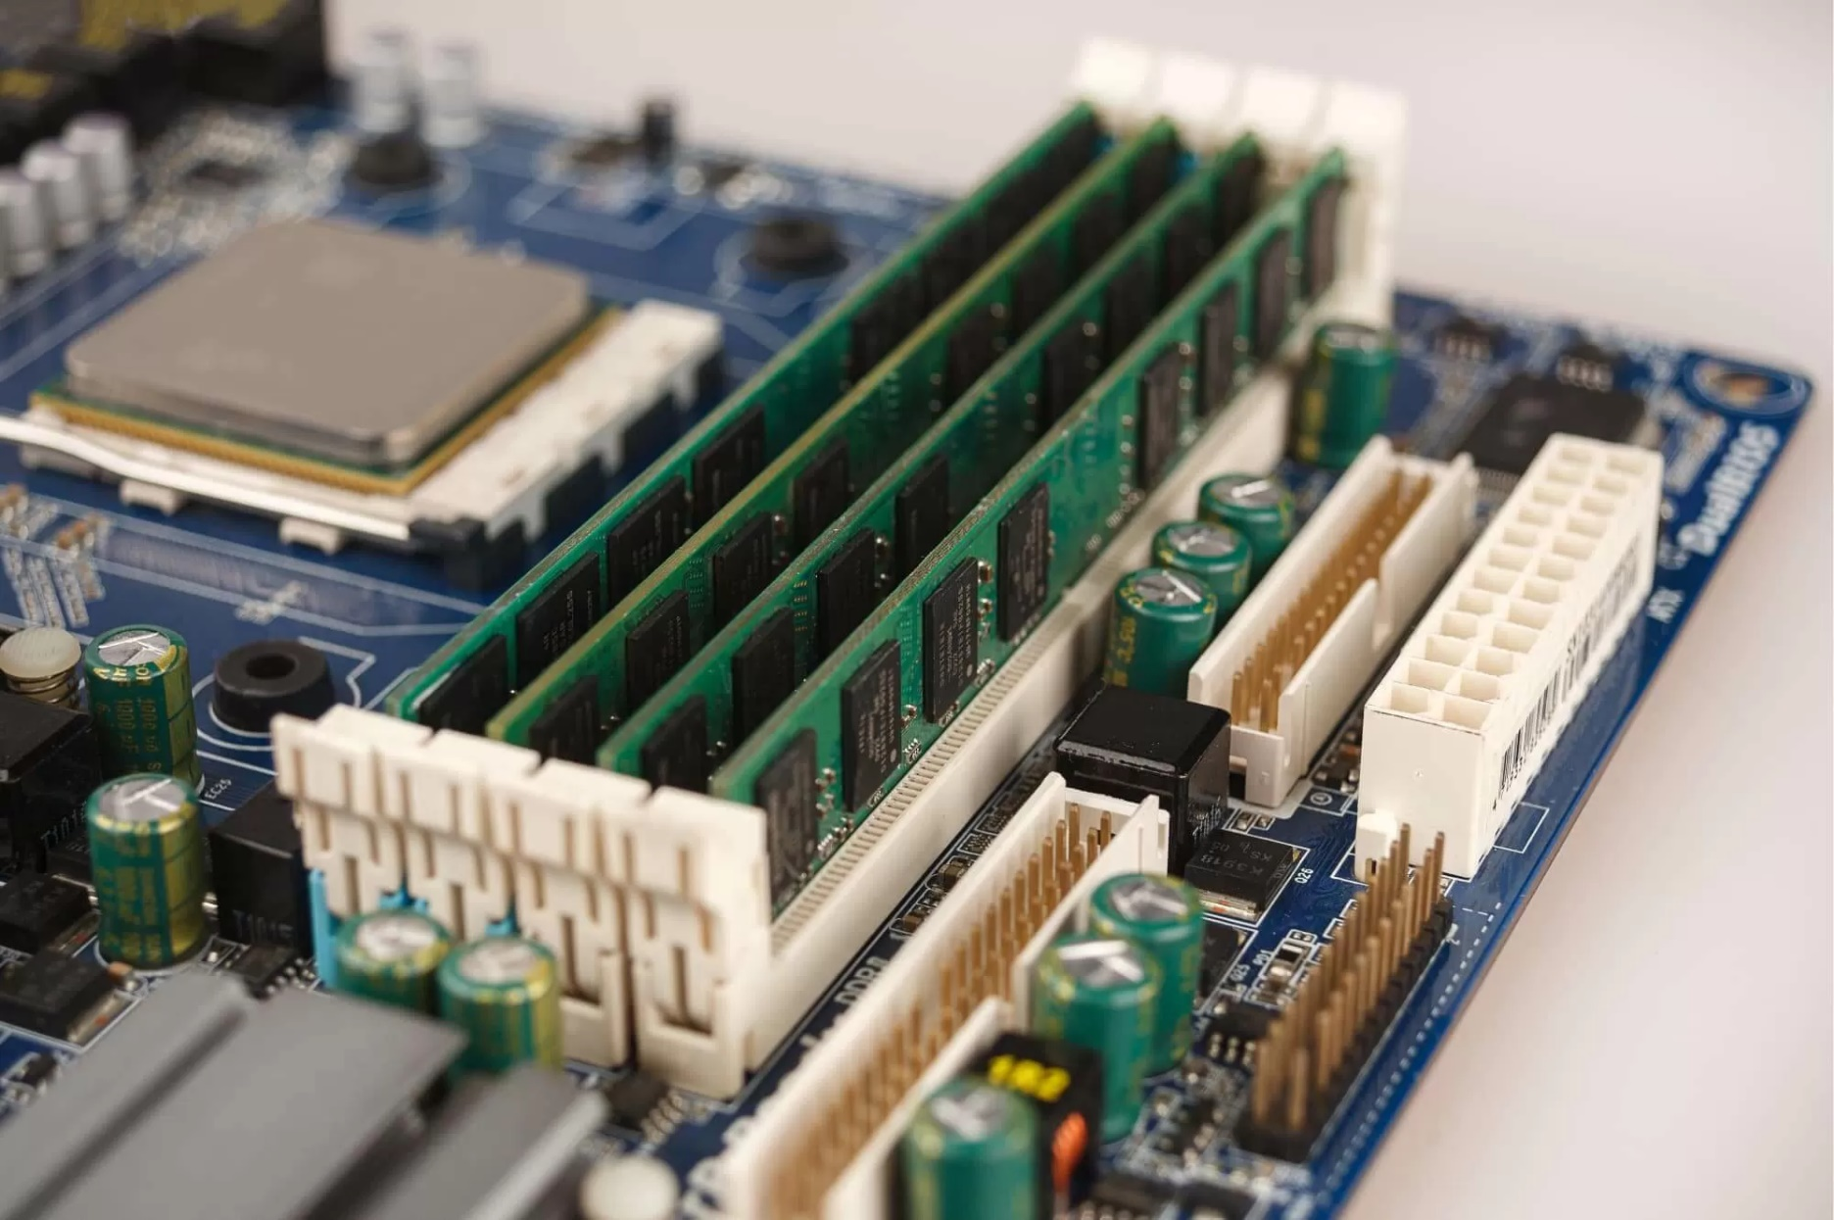
Processor and Memory
Processor
Memory

Slide 88
Width of Data Bus
4-bits (nibble)
8-bits (byte)
16-bits (word)
Generally: Wider bus → Faster computer
Notes:
32-bit instruction:
4-bit bus: 32 / 4 = 8 operations
16-bit bus: 32 / 16 = 2 operations
Current: 64-bit data bus

Slide 89
Width of Data Bus
Notes:
32-bit instruction:
4-bit bus: 32 / 4 = 8 operations
16-bit bus: 32 / 16 = 2 operations
Current: 64-bit data bus

Slide 90
Memory & Buses
1
01110010
Address bus
ALU
01110010
11011011
2
Read line
CU
11011011
Write line
Registers
11011011
Data bus
Processor
3
Memory
Notes:
Read (Info only – Higher)
CU transfers address in register to Address Bus
CU activates Read line
Data transferred from memory to Registers using Data Bus
Write (Info only): 1. CU transfers address and data to buses 2. CU activates Write line 3. Data transferred to specified address in memory.

Slide 91
Memory & Buses
ALU
Read line
CU
Write line
Registers
Processor
Memory

Slide 92
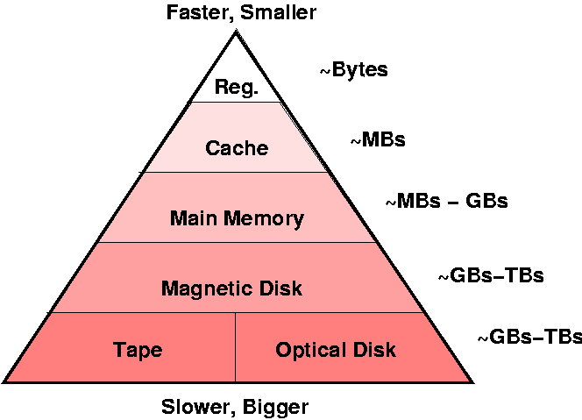
Hierarchy of storage - TBC / redrawn

Slide 93
Interpreters and Compilers
Notes:
2018 Spec Q19(d) 2022 Q9(d) 2023 Q11(c)

Slide 94
Learning Objectives
Explain the need for interpreters and compilers to translate high-level program code to binary (machine code instructions).

Slide 95
What is Understood?
Humans
Computers
1 name = input("Name? ")
2 print("Hello " + name)
100101110100101010101010
010101010100010111101010
High Level Language
(Python)
Low Level Language
(Machine Code)

Slide 96
What is Understood?
Humans
Computers
1 name = input("Name? ")
2 print("Hello " + name)
100101110100101010101010
010101010100010111101010

Slide 97
Interpreter
Source code
Get next
line of code
Interpret a
line of code
Success
Failure
Run machine code
Report
error

Slide 98
Interpreter

Slide 99
Compiler
Source code
Compile all code
Success
Failure
Create executable file
Report
error(s)

Slide 100
Compiler

Slide 101
Comparison of Translators
Interpreter
Compiler
one line translated at a time
code translated every time
position of errors in code identified during test run
don't have to leave editing environment
compiled code runs faster
code is only translated once
compiled code requires less memory to execute
compiled code cannot be edited

Slide 102
Environmental Impact
Computer Systems
Notes:
2018 Q22(c) 2022 Q10(d)(ii) 2023 Q3

Slide 103
Learning Objectives
Describe the energy use of computer systems, the implications on the environment and how these could be reduced through:
settings on monitors
power down settings
leaving computers on standby
Notes:
Automating / removing humans from the decisions.

Slide 104
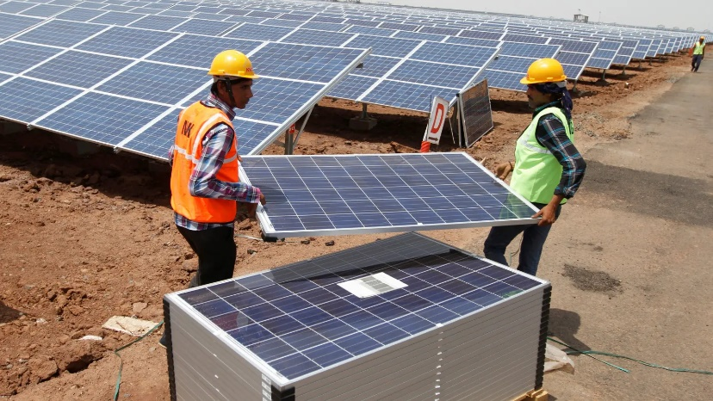
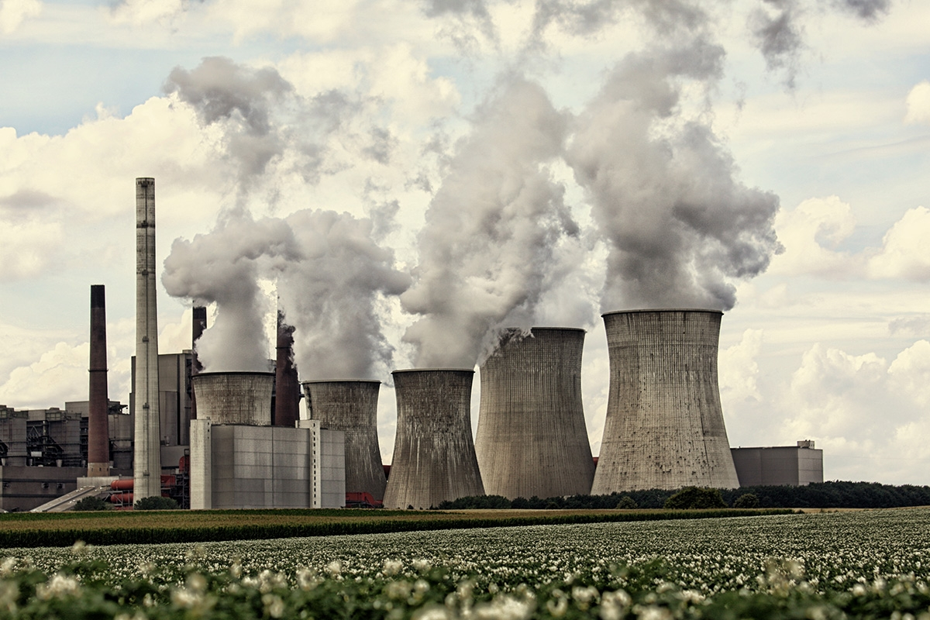
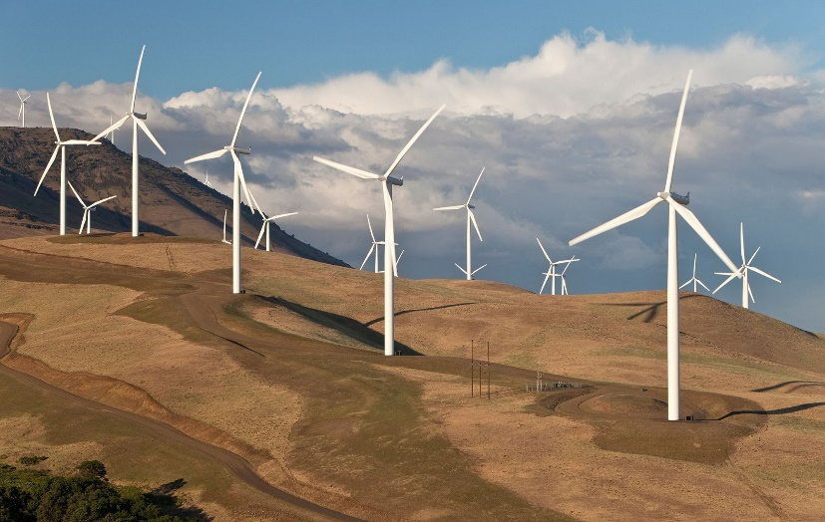
Energy
Solar, Wind, Hydro
Coal, Gas, Oil
Notes:
Nuclear – green? No carbon!

Slide 105
Monitors
Reduce brightness
Sleep (Turn off screen)
Standby mode after a period of time
Switch off when not in use

Slide 106
Monitors

Slide 107
Computers
Turn off hard drives
Reduce clock speed
Close unused applications
Network, turn off:
Bluetooth
WiFi
Sleep
Hibernate
Switch off when not in use

Slide 108
Computers

Slide 109
Security Precautions
Computer Systems

Slide 110
Firewalls
Notes:
2018 Spec Q5(a) 2019 Q15(d)

Slide 111
Learning Objectives
Describe the role of firewalls.

Slide 112
Firewall
F
i
r
e
w
a
l
l
Internet
Network
Restricts access to a network
Notes:
Use rules to allow or deny data to pass through
https://www.simplilearn.com/tutorials/cyber-security-tutorial/what-is-firewall

Slide 113
Firewall

Slide 114


Firewall
A firewall is a system designed to protect against unauthorised access to or from a private network
Firewalls contain rules and conditions which specify what is, and what is not allowed to pass through.
Notes:
Restricts access to a network

Slide 115
Encryption
Notes:
2018 Spec Q5(b) 2018 Q6 2021 Q6 2022 Q8(d) 2023 Q2

Slide 116
Learning Objectives
Describe the use made of encryption in electronic communications.

Slide 117
Encode / Encrypt
Encode
Encrypt
Data readable
ASCII encodes text:
A is always 65
Z is always 90
Data unreadable, without key
Caeser cipher encrypts text:
A could be B to Z
Z could be A to Y

Slide 118
Encode / Encrypt
Encode
Encrypt
Data
ASCII
A is
Z is
Data
Caesar cipher
A could
Z could

Slide 119
Unencrypted data

Slide 120
Encryption
Scrambles data
Unreadable
Tries to prevent unauthorised access to content

Slide 121
Encrypted data

Slide 122
Decryption
Unscrambles data
Make readable

Slide 123
Encryption
Encrypted text
Encrypt
Decrypt
Plain text
Plain text
Key
Key
Tries to prevent unauthorised access to content

Slide 124
Encryption
Tries to prevent access to content

